Slide 1

Azure Synapse -II
Modern ETL Tool

Slide 2
Context::
Query JSON Files: 3 - 10
Query Parquet Files : 11 - 14
Query Delta Files : 15 – 16
Spark Pool Creation : 17
Synapse Pipelines : 18

Slide 3
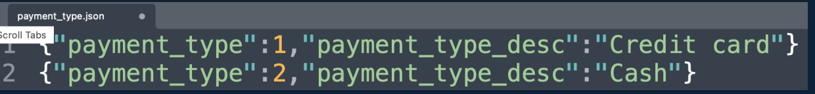
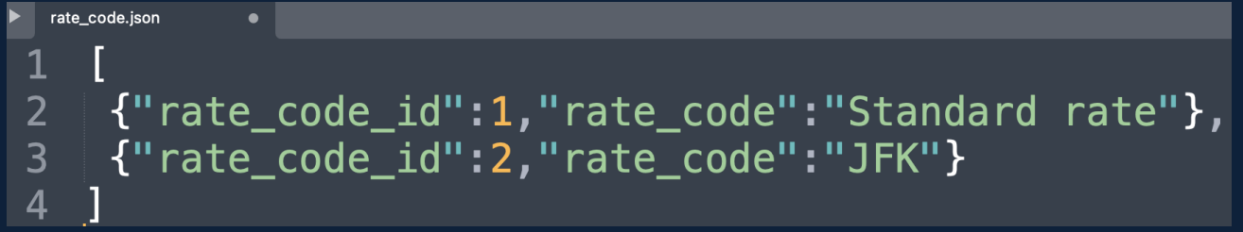
::Query Json files::
Json files are considered as one of the semi-structured data files . Json files are considerably 3 types
1) Line Delimited Json , 2) Single Line or standard Json , 3) Classic Json
1
2

Slide 4
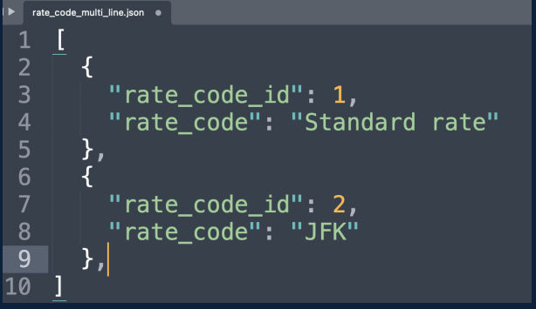
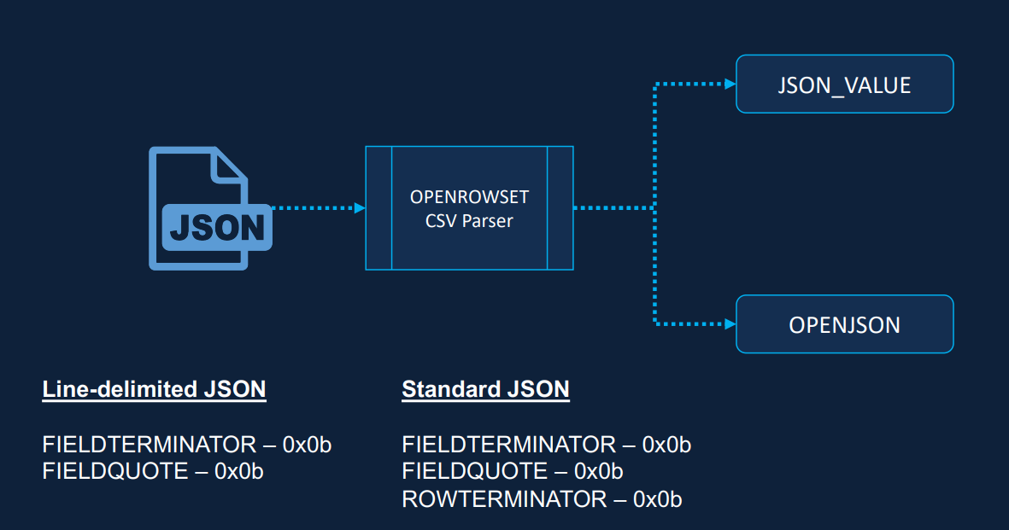
Continue….
Classic Json or multi-line Json look’s like
To read or querying the Json files use csv parser in openrowset function with some Json formats
Useful : https://medium.com/@diangermishuizen/query-json-data-in-sql-server-and-synapse-analytics-5147b2288e86
https://learn.microsoft.com/en-us/azure/synapse-analytics/sql/query-json-files
3
Json_value : extracts elements and values into columns and rows . Used for Line delimited
OpenJson : Same as Json_value, but used for large Json files like standard and multi-line Json

Slide 5
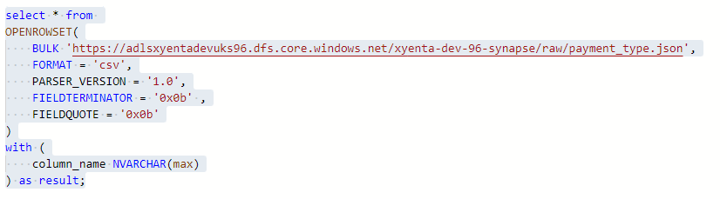
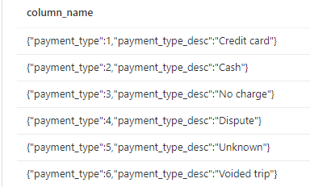
::Read Line delimited Json file::
For line delimited Json we use openrowset with csv parser with fieldterminator and filedquote to eliminated the quotes in data .
When ever you are using csv parser_version = ‘1.0’ we need to specify the column_name (a dummy name ) inside the with clause
Use Json_value to pull out properties of payment_type and payment_type_description as rows and columns and specify the datatypes for them using cast
1
Output

Slide 6
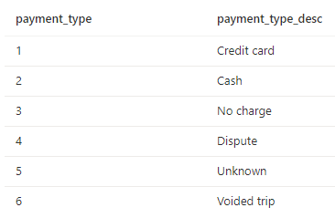
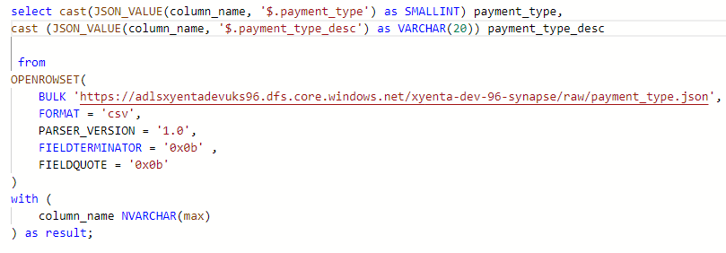
Continue…..
Query
Even though the Json_value function gives us the ability to parse the Json data and turn that into rows and columns, But it can explode and array and every time we need to explicitly use cast to define the datatypes . So , we can also use OpenJson for Line-delimited as well , here we can define data types without cast
Moreover, it provides richer functionality and fast in performance wise when compared to Json_value like we can rename the columns etc.,
Output

Slide 7
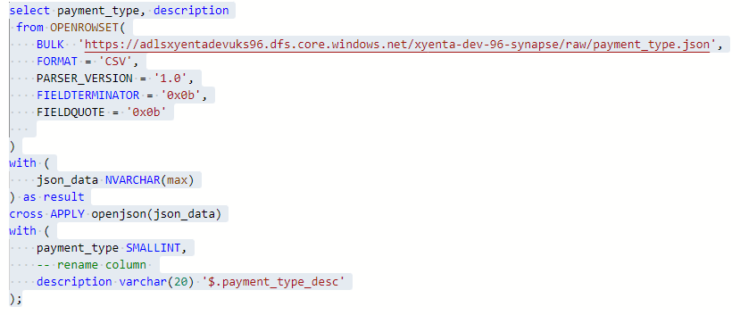
Continue:::
Let’s see how we can read the Line-delimited Json file with OpenJson function

Slide 8
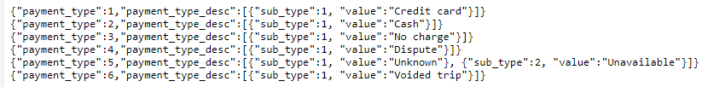
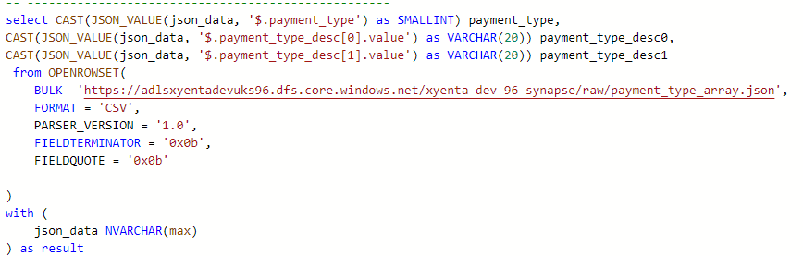
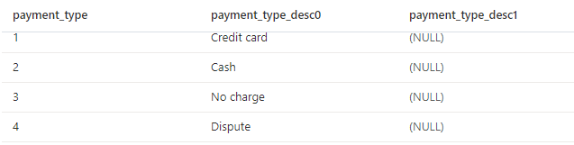
::Read or Query Json Array File::
Let’s take a Json file with arrays in the data and query using OpenJson Function. But firstly, we will see how to query this file using Json_value
So, with the Json_value function we are not properly parsed the data within the array. Now let’s see how we can parse that one using OpenJson
output

Slide 9
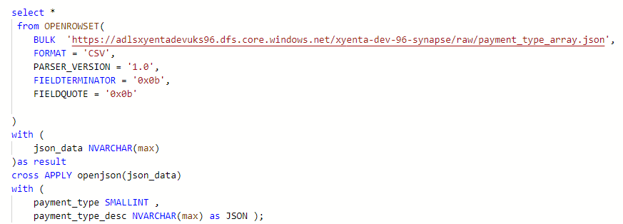
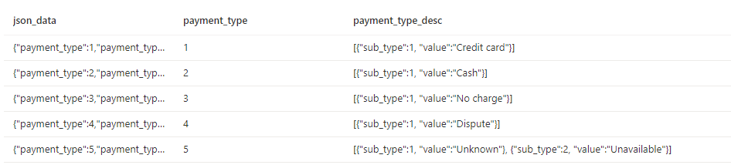
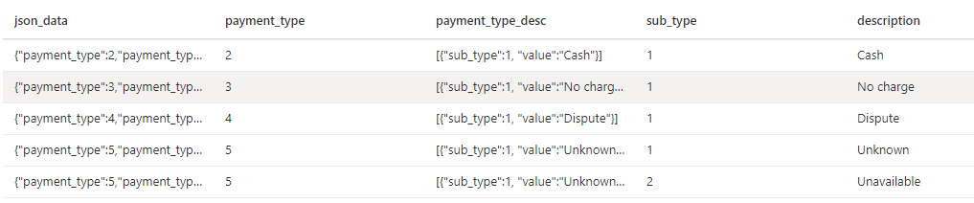
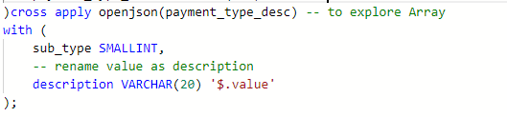

Continue::::
1
output
2

Slide 10
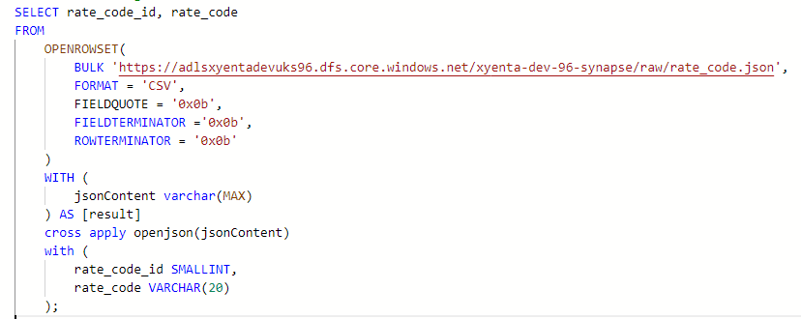
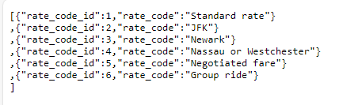
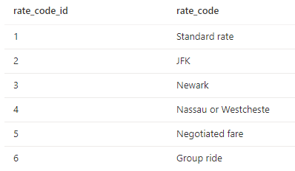
::Query standard Json File::
Now, we will see how we can query a Json file of standard and multi-line Json file by using OpenJson function and with additional formatter called RowTerminator .
Even for Multi-line Json file , we have to use same
Code only
Query
output

Slide 11

::Query Parquet Files::
Parquet files are most used files in data world , because of it feature like, it adopts columnar basis’s iteration, and it consumes less storage space .
In general, we divide huge amount data into small chunks called (partition) and store chunks as parquet files
For example , we have a file with columns like year, units_sold, total_amount. Now I want to do portion on top of Year . So, all the records of particular year under one cover or partition
Let’s consider we have a data in our storage account like this
Trip_data_green
Under Trip_data_green folder, data portioned by year and month
Year = 2020
M=01
File.snappy.parqut
M=02

Slide 12
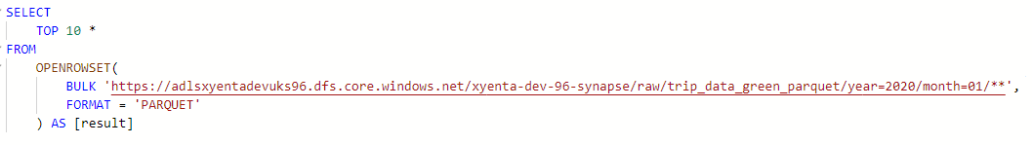
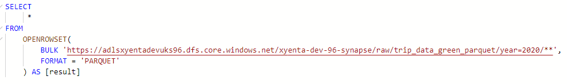
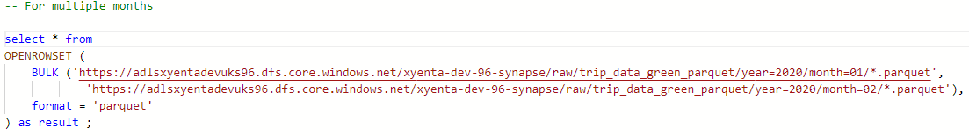
Continue::::
Let’s query the file which is year=2020 and month=01 portion like this ‘**’to query all files, present in that partition . Here no need of Header_row formatter
Query to get all records from year of portion 2020
For multiple months in a year

Slide 13
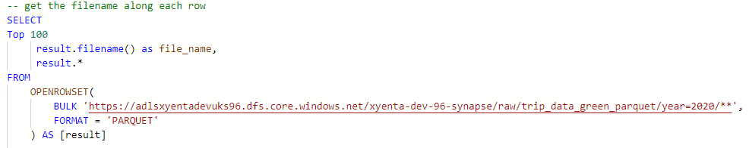
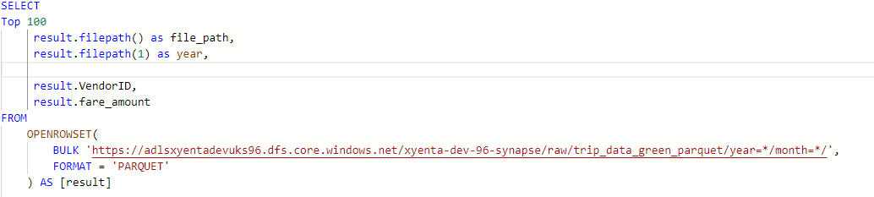
Continue:::::
To get all years, months data
Get the filename along side of each record or row
Get the filepath or portion year

Slide 14
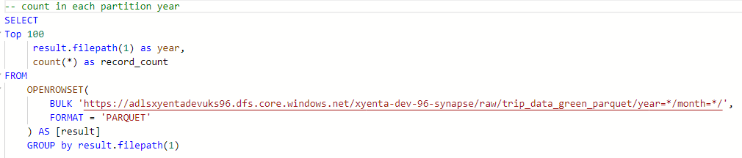
Continue:::
Let’s get the count of for specific partition year
Note, You can use filepath(), filename() for any kind of files like csv, Json etc.,

Slide 15

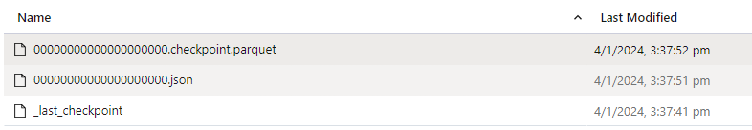

::Query Delta Files::
As we discuss earlier in detail about Delta Files (aka delta tables ). Delta Table is formed with combination of Json and parquet file types ( or Delta Logs) . If any folder consists of Delta Logs folder, then you can say it’s folder of Delta Files or Delta Tables .
Data will store as parquet files only . The possibility to read Delta format using T-SQL is one of the newer features in the Serverless SQL pool
Unlike csv/parquet files , the Delta Tables query from main folder (Trip_data_green). Can’t query subfolder or files directly
_deltalogs
Useful link : https://learn.microsoft.com/en-us/azure/synapse-analytics/sql/query-delta-lake-format
Year = 2021

Slide 16
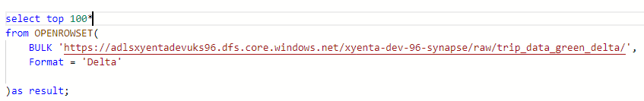
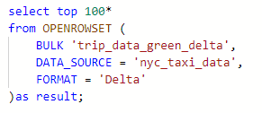
Continue::
Query with openrowset function
Query with external Data source
We can’t directly apply filename and filepath . But we can use indirectly with help of spark or spark sql
The main difference between Delta and parquet is that Delta keeps a transaction log (think of SCD scenarios, or point-in-time analysis)

Slide 17
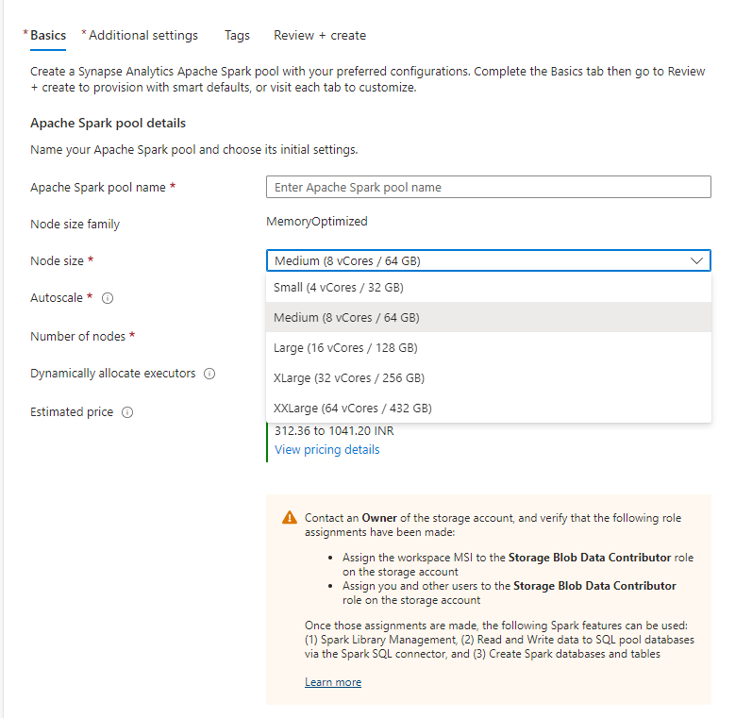
::Spark Pool Creation::
Spark Pool is used to create the Spark Environment for Big Data Processing . One of the most important component of Spark environment is a “Cluster”
Go to Azure Synapse Analytics workspace and click on plus for New Spark pool creation
In Basics Tab: Give the meaningful name for the spark pool
Select The Node or Worker size (Node = CPU)
Then select Number of Nodes also click on Auto Scale and Dynamically allocate executors
In Additional Settings Tab Always select Automatic pausing enabled . Select the spark versions
Later click on Review + create
Useful link :https://www.sqlshack.com/working-with-spark-pools-in-azure-synapse-analytics/

Slide 18
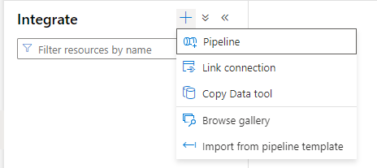
::Synapse Pipelines::
Synapse Pipelines and ADF pipelines both shares the same code base and works in a same fashion.
click on Pipelines to create pipelines
Link connection nothing but a Linkedservice
For the Azure SQL DB
Copy Data Tool is a pipeline (read made pipelines) to copy the
Data from one to another
Useful link : https://learn.microsoft.com/en-us/azure/synapse-analytics/get-started-pipelines

Slide 19


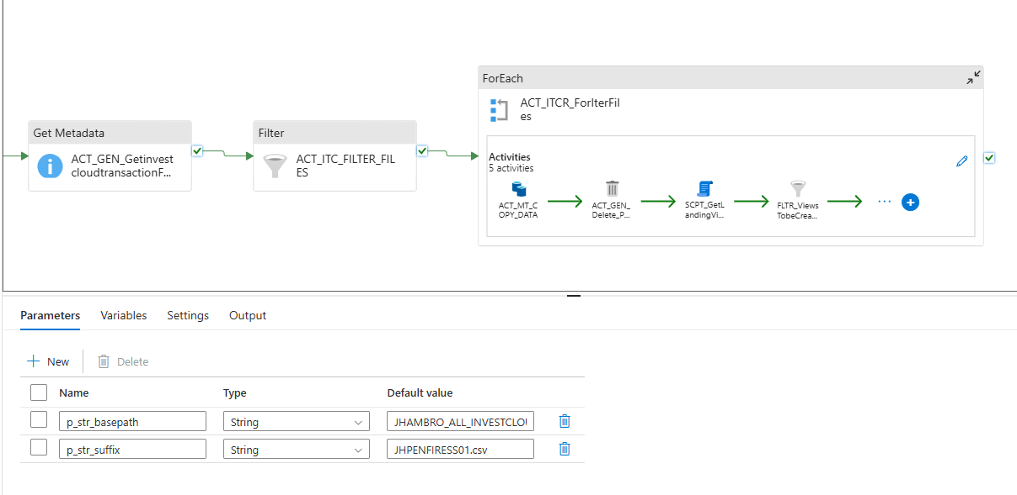
To

Slide 20
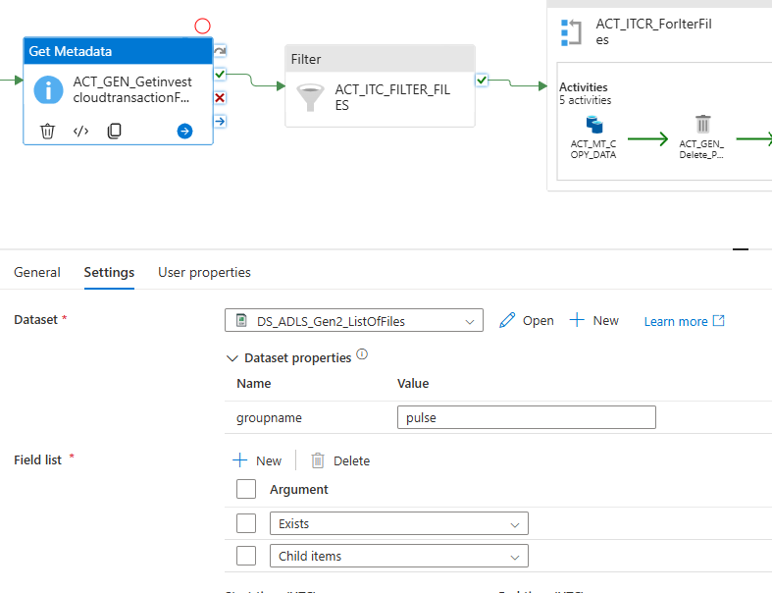
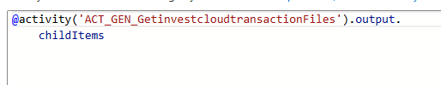
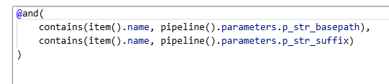

Slide 21
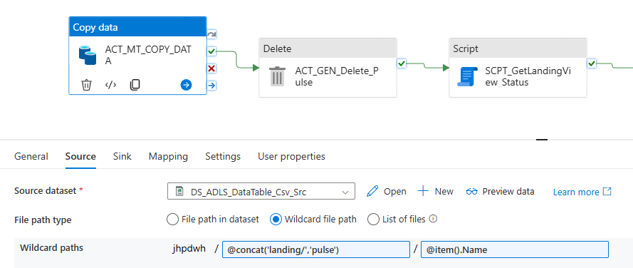
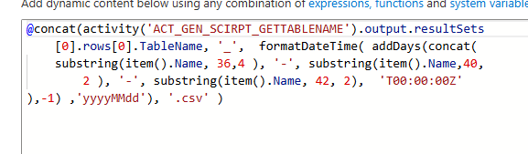

Slide 22
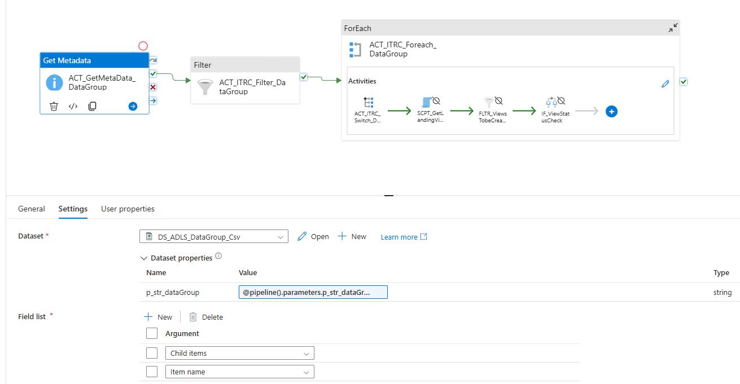
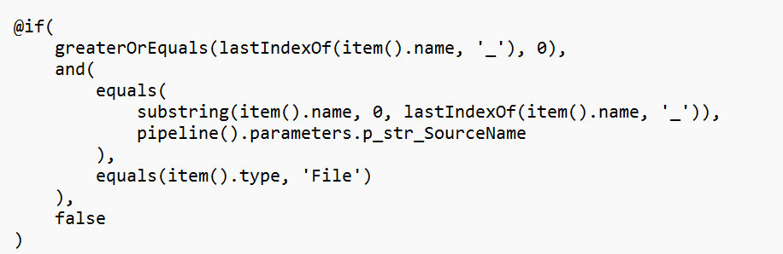
PL_LandingDataTable :

Slide 23
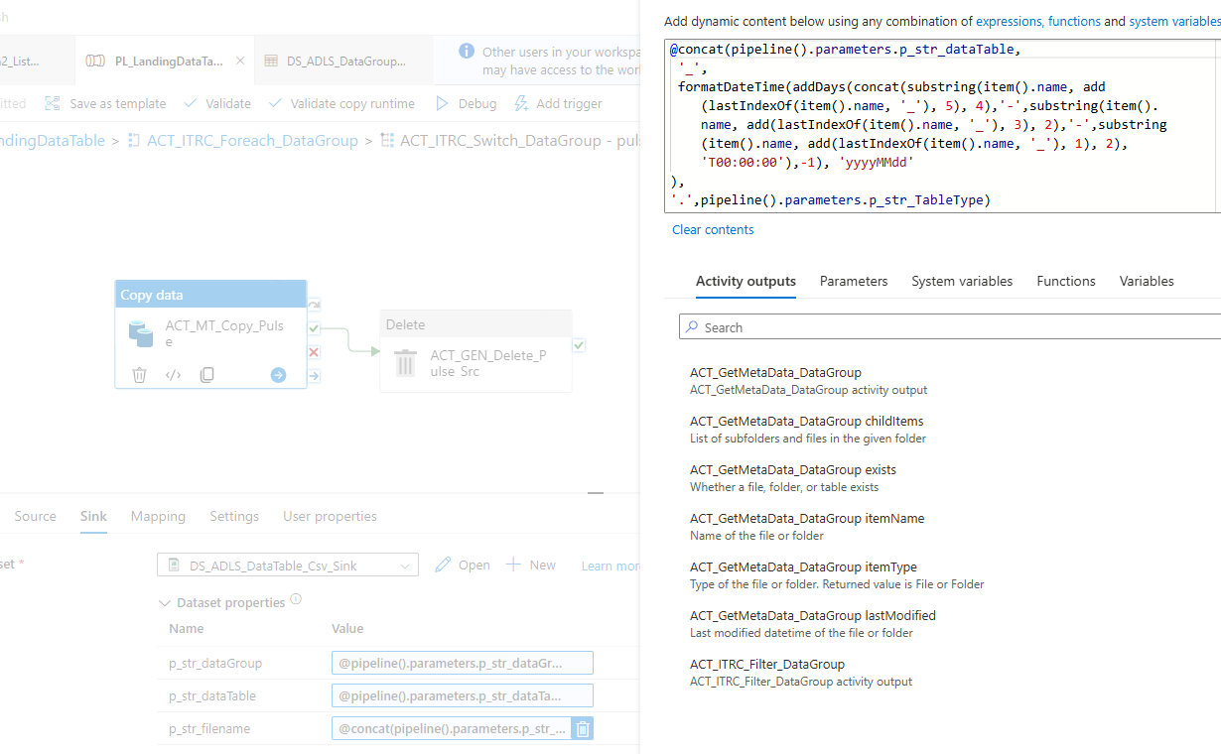
Sink code for file looks like this
File_ddmmyyyy.csv to file_yyyymmdd.csv

Slide 24
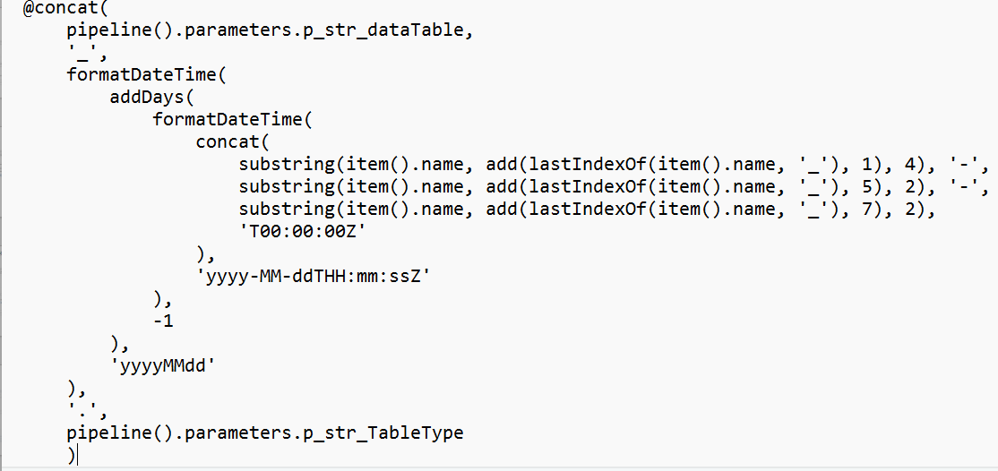
For client_assets_202507220605.csv
To
Client_assets_20250722.csv

